Slide 1


2023 Program Report
January 2024
Notes:
1

Slide 2
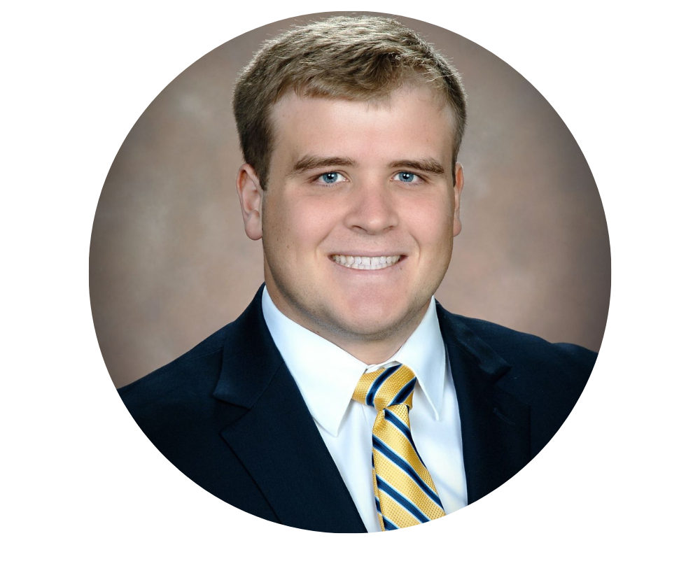
Overview
  Helps address the crucial challenge facing the field of power and energy – shortage of power engineers needed to sustain and transform electric energy systems upon which the United States & Canada so heavily rely
  Awards scholarships (up to US$7,000 over three years) to undergraduate electrical engineering students to attract top talent to the power and energy field
  Connects scholars to companies seeking highly qualified interns and co-op students giving them vital career experience prior to graduation
Notes:
Established in 2011 joint program between PES & Foundation

Slide 3
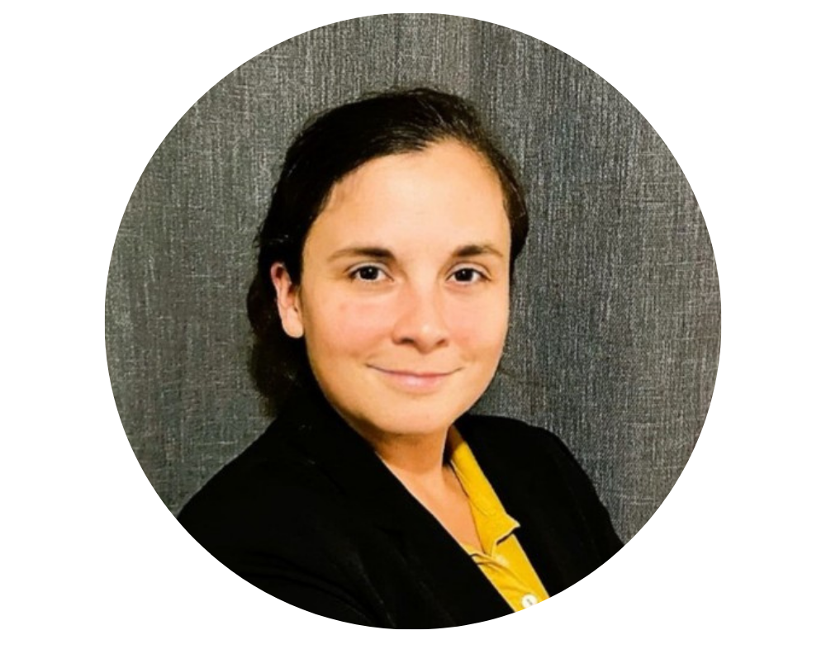
Program Success
1,213 students earned 2,038 scholarships since 2011
  Increasing gender diversity - 25% of all PES Scholars are female
Built a pipeline of power engineers - Over 780 PES Scholarship recipients are working full time
Created power engineering career awareness
Revitalized power and energy curriculum
Raised $9.0M+ in support of program
Built a recognizable brand for IEEE
Increased student awareness and membership in PES
Connects students and industry
Program expanded to Canada, Puerto Rico, India, & Italy

Slide 4
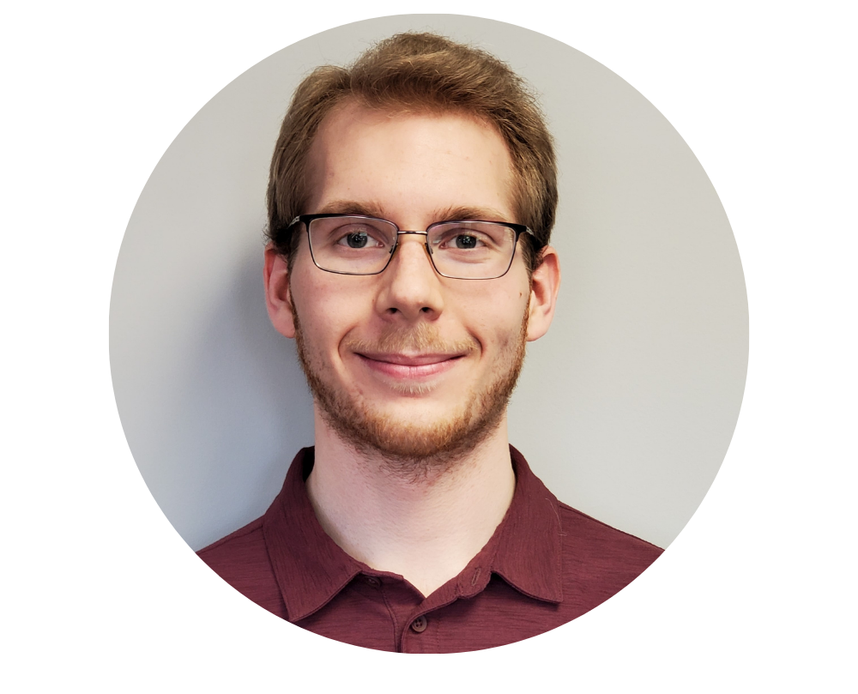
PES Scholars Receive
Up to US$7,000 in financial support:
  US$2,000 1st/2nd year - US$3,000 3rd year
Connections and assistance in earning power engineering career experiences
One free year of membership in IEEE & PES – student must pay for additional years if they want scholarship renewed
Access to PES mentors - industry professionals
Top Scholar in each Region (1-7) receives an additional $6,000 & up to $1,000 to attend the PES General Meeting or PES Transmission & Distribution Conference & Exposition
Notes:
4

Slide 5
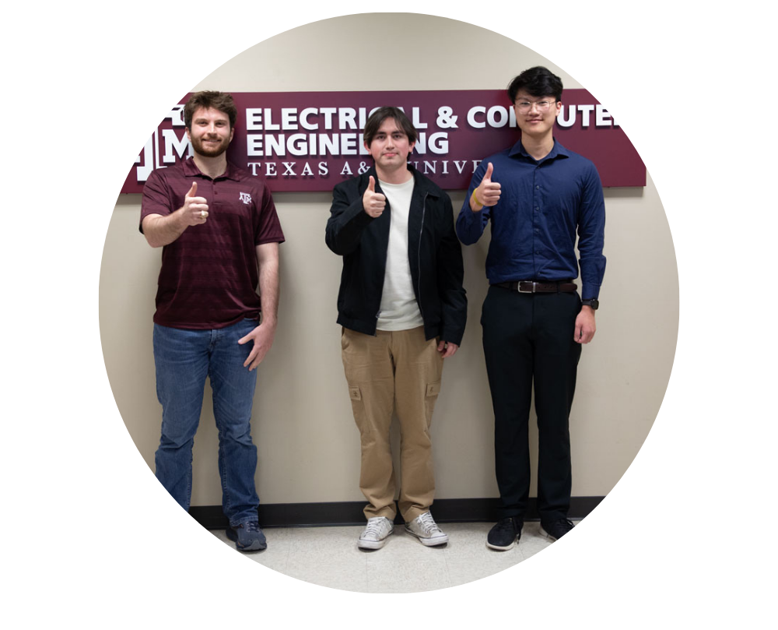


2023 Highlights
PES Scholars from the Texas A&M University

Slide 6

2023/2024 PES Scholars
Awarded US$239,000 in PES Scholarships to 82 students
from 58 universities across the U.S., Canada & Puerto Rico – 32% were female.
Additional recognitions
  Seven (7) individuals received the IEEE PES John W. Estey Outstanding Scholar Award
  Support from the G&W Electric Company enabled 14 students from following schools to be recognized - Ohio Northern University, Iowa State University, South Dakota State University & University of Nebraska
  The Anne-Marie Sahazizian Scholarship fund supported 13 students from Canada & the USA
  IEEE PES G. Ray Ekenstam Memorial Scholarship recipient selected from PES Scholars
  Link to 2023/2024 PES Scholar Listing
Notes:
Help industry recruit top candidates from the finest engineering programs in the U.S.
Give young engineers the tools to connect with potential employers
Provide mentoring opportunities for PES Scholars from current experts

Slide 7
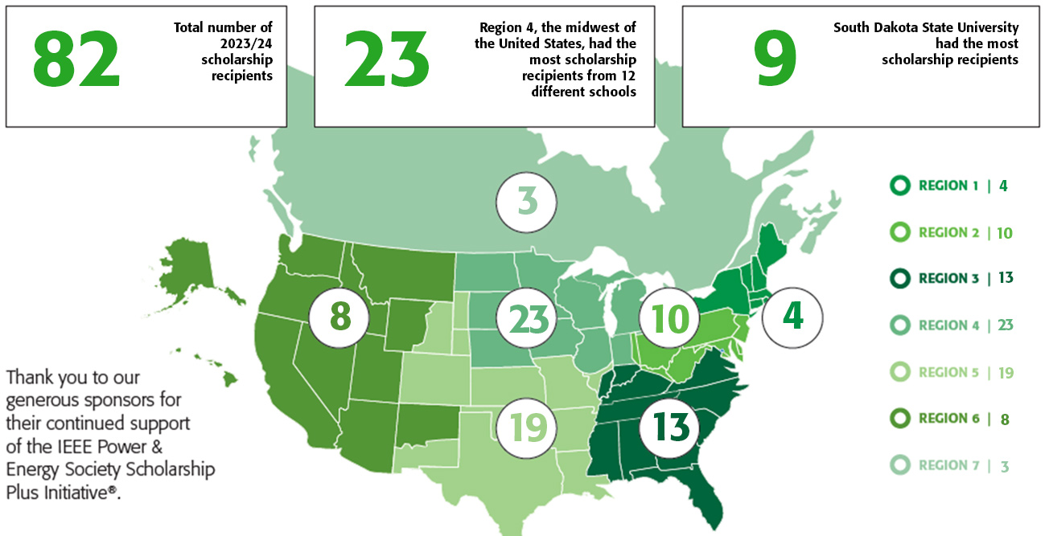
2023 Scholarship Summary

Slide 8
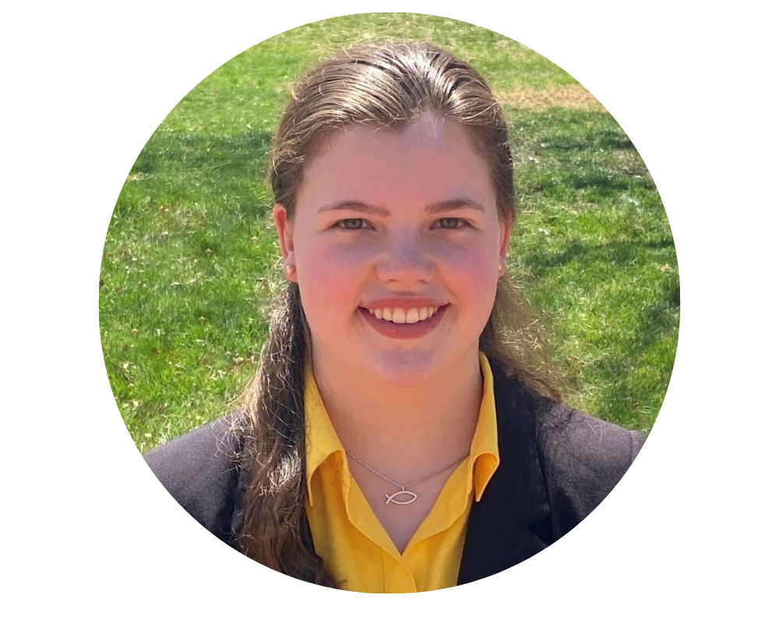

PES & Female Scholars by Year
The number of new scholars is dependent on new (or annual) funding being provided to the program.
32% of the top scholars selected have been female

Slide 9


PES Scholar Distribution - Schools
All Time
Recipient every Year
219 schools in Canada, Puerto Rico & USA
85% of the schools have recipients for multiple years
Region 6 (Western USA) has had scholars at the most schools 39
67 - Drexel University
64 - Arizona State University
61 - South Dakota State University
57 - University of Illinois at Urbana-Champaign
51 - Washington State University
44 - Worcester Polytechnic Institute
42 - North Carolina State University
42 – University of Pittsburgh
40 - State University of New York at Buffalo
40 – Texas A&M University
36 - University of Washington

Slide 10















PES Scholars are working at…
300+ organizations

Slide 11
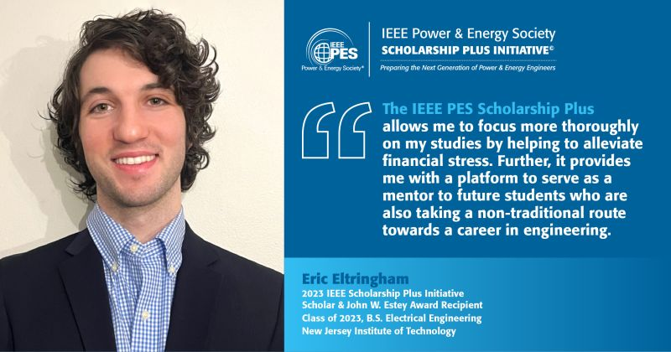
PES Scholar Profile
Eric Eltringham – New Jersey Institute of Technology
When he took a job as an electrician after high school, he had no idea doing so would lead him to return to school and subsequently find his vocation in electrical engineering and power systems – but it did.
As he looks toward the future, his primary goal is to continue to learn as much as possible. He would also like to do would be to mentor other nontraditional engineering students such as himself.
https://ieee-pes.org/member_profiles/eric-eltringham/

Slide 12
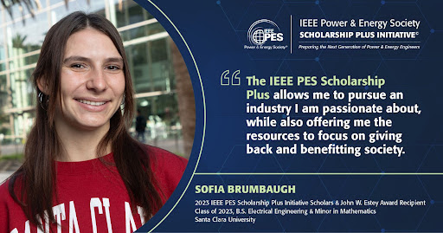
PES Scholar Profile
Sofia Brumbaugh – Santa Clara University
Her interest in engineering bloomed after attending a summer program in high school that introduced her to different disciplines in the field.
One of the things that Santa Clara University’s engineering program provided Sofia that she wasn’t expecting but has benefited greatly from was the fact that the faculty includes many female members.
The mentorship she has received has helped to shape her career focus: power and control systems.
https://ieee-pes.org/member_profiles/sofia-brumbaugh/

Slide 13
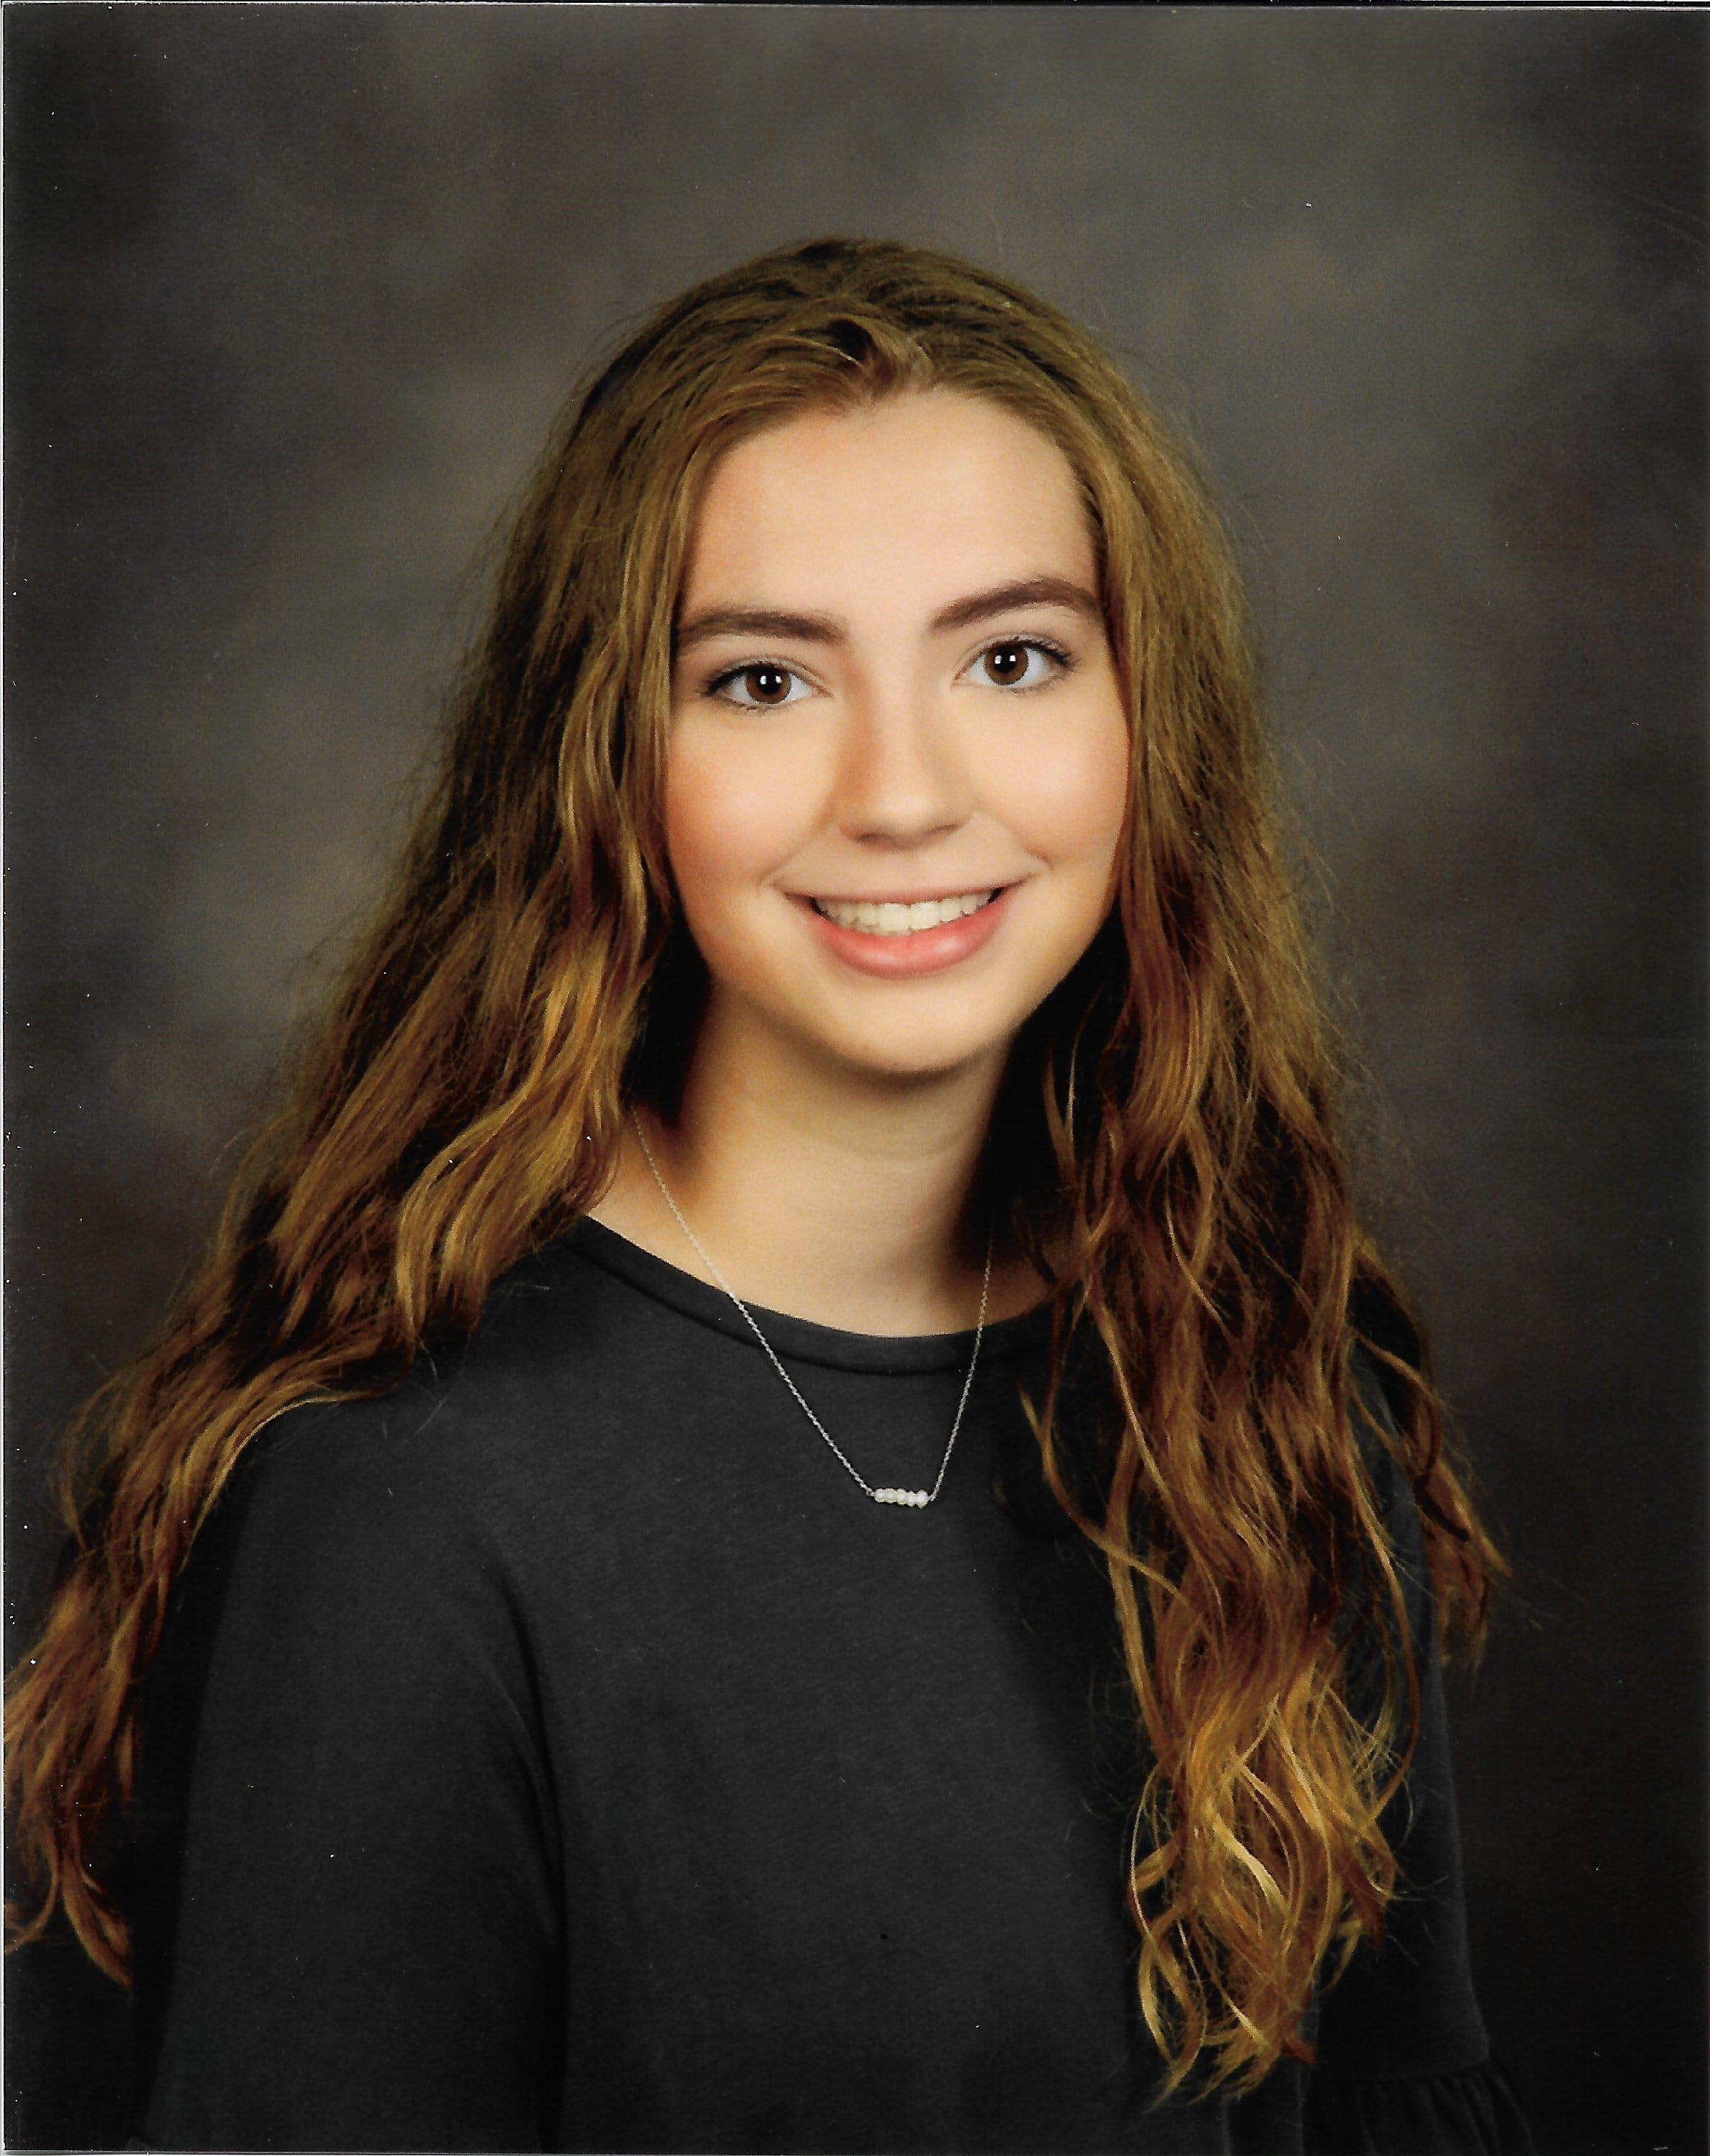
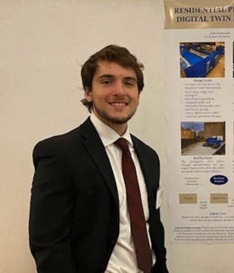
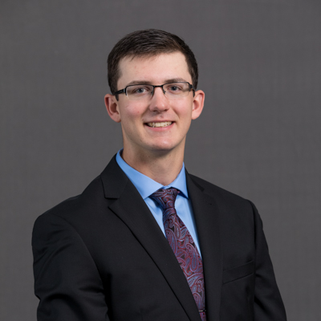
Additional Profiles
Promoted via PES Social Media, Newsletter, etc
Sarah Aman – South Dakota State University
Jack Carnovale - University of Pittsburgh
Tyler Fogelson - South Dakota State University
https://ieee-pes.org/about-pes/member-profiles/

Slide 14
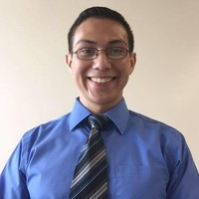
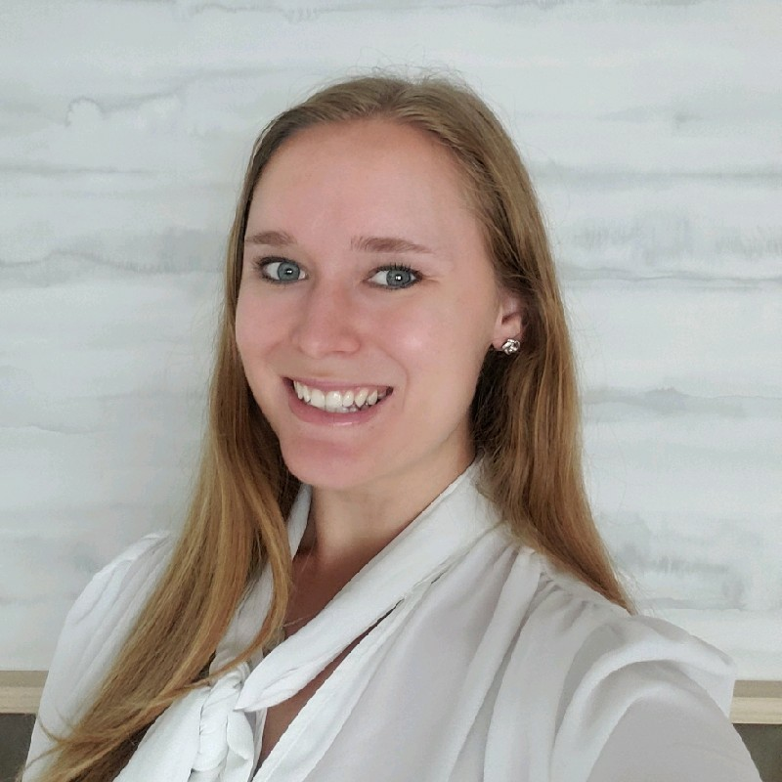
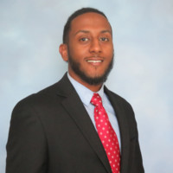
PES Scholar Alumni
Benjamin Franco
Protection & Control Engineer at Eversource Energy
Wentworth Institute of Technology (2016)
Megan Culler
Idaho National Laboratory
Texas A&M University (2019)
Abel Belete
Transmission Protection & Control Field Engineer
Georgia Power Company
University of Georgia (2019)

Slide 15



Organizational Supporters
Presidential Level ($1,000,000+)
Platinum Level ($500,000)
Diamond Level ($250,000)
Anonymous Donor
Gold Level ($100,000)

Slide 16


Organizational Supporters
Silver Level ($50,000)
Bronze Level ($25,000)
Phi Gamma Delta of MIT

Slide 17

Volunteer Leadership
Regional Review Committee Chairs
  Region 1 – Subhadarshi Sarkar
  Region 3 – Hasala Dharmawardena
  Region 2 – Robert Kerestes
  Region 4 - Brianna Swenson
  Region 5 – Julia Matevosjana
  Region 6 – Jesus Sanchez
Vice President - Education
Nirmal-Kumar C. Nair

Slide 18
Final Comments
We need support to ensure the initiative continues to have an impact in the lives of students and the industry.
Students are inspired by and thankful for the program.
Alumni laud the impact the program had on their lives and career path.
Industry partners continue to express the need for the program

Slide 19
Questions – contact pes@ieee.org or donate@ieee.org

